Slide 1
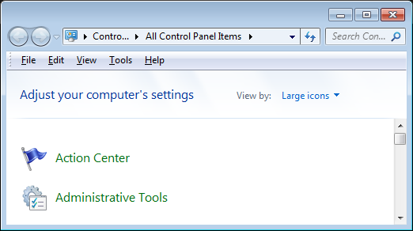
OS
Event Log
Event Viewer is a tool that displays detailed information about significant events (for example, programs that don't start as expected or updates that are downloaded automatically) on your computer. Event Viewer can be helpful when troubleshooting problems and errors with Windows and other programs.

Slide 2
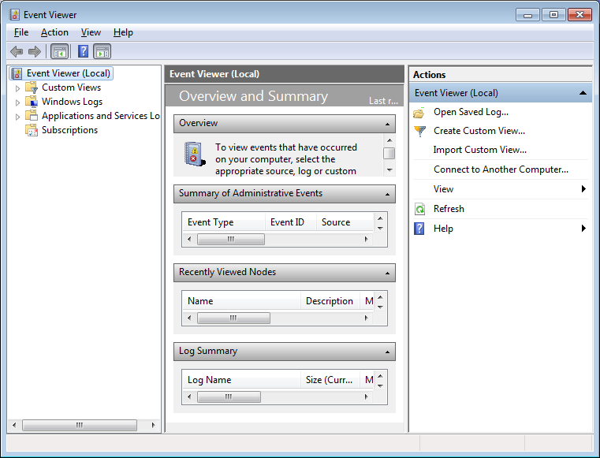
OS
Event Log

Slide 3
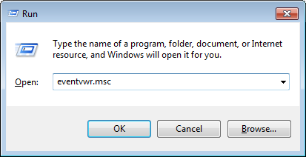
OS
Event Log
+
R

Slide 4
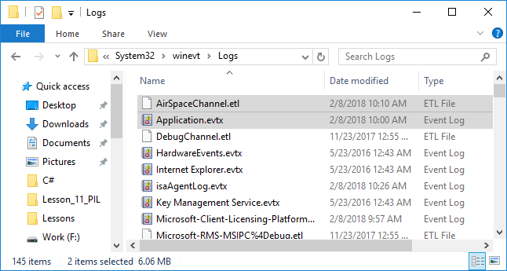
OS
Event Log

Slide 5
OS
Event Log
EVTX File Extension
Log file created by the Windows 7 Event Viewer;
contains a list of events recorded by Windows;
saved in a proprietary binary format that can only be viewed within the Event Viewer program.

Slide 6
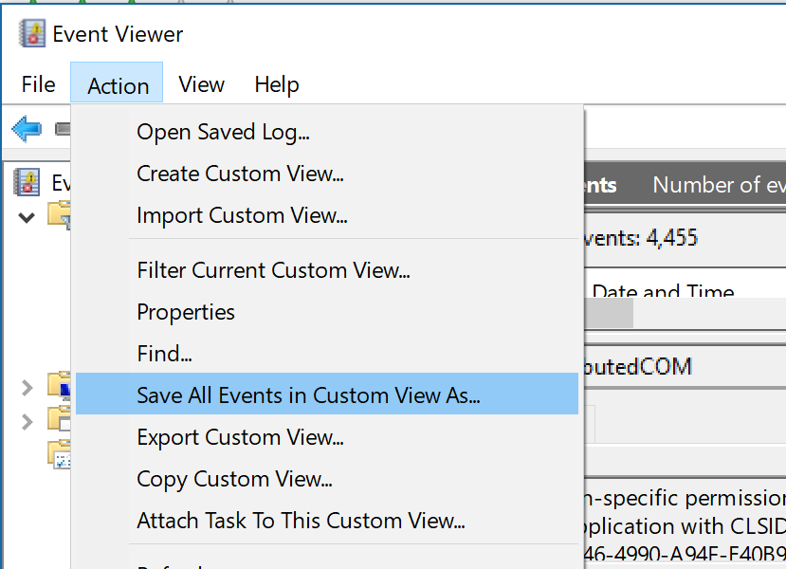
OS
Event Log

Slide 7
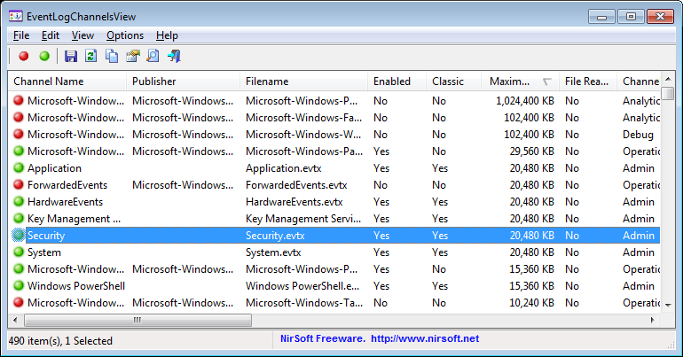
OS
Event Log
EventLogChannelsView v1.16
https://www.nirsoft.net/utils/event_log_channels_view.html

Slide 8
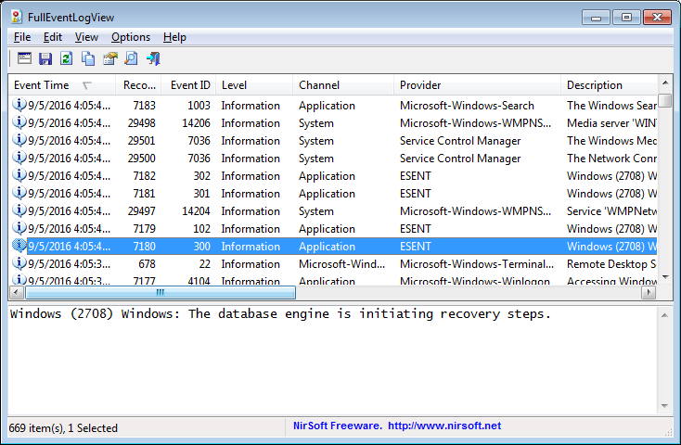
OS
Event Log
FullEventLogView v1.26
https://www.nirsoft.net/utils/full_event_log_view.html

