Slide 1
ConEmu
ConEmu - Windows console with tabs
https://sourceforge.net/projects/conemu/
https://conemu.github.io/
ConEmu-Maximus5 is a Windows console window enhancement (local terminal emulator), which presents multiple consoles and simple GUI applications as one customizable tabbed GUI window with various features.

Slide 2
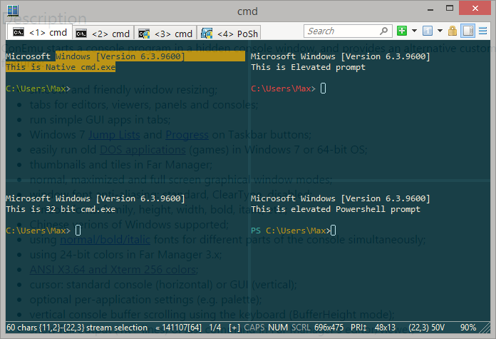
ConEmu
ConEmu - Windows console with tabs

Slide 3
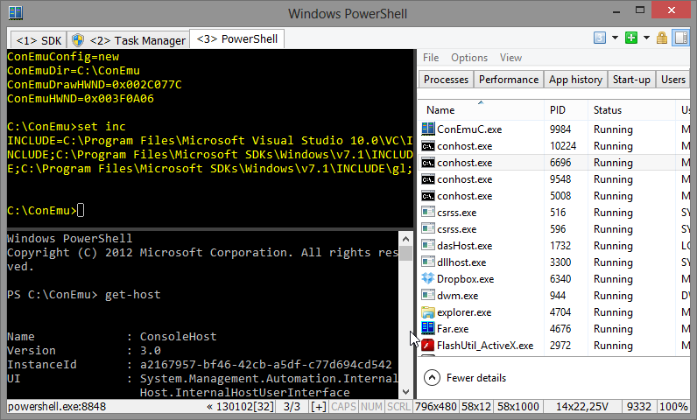
ConEmu

