Slide 1
PIL
Python Imaging Library
PIL support for opening, manipulating, and saving many different image file formats.
Pillow is the “friendly” PIL fork.
Python Tutorial: Image Manipulation with Pillow https://www.youtube.com/watch?v=6Qs3wObeWwc
http://pillow.readthedocs.io/en/latest/handbook/tutorial.html
Pillow (PIL Fork) Documentation:
https://media.readthedocs.org/pdf/pillow/latest/pillow.pdf

Slide 2
PIL
Installation 2017
Python 3.6.2
https://www.python.org/downloads/

Slide 3
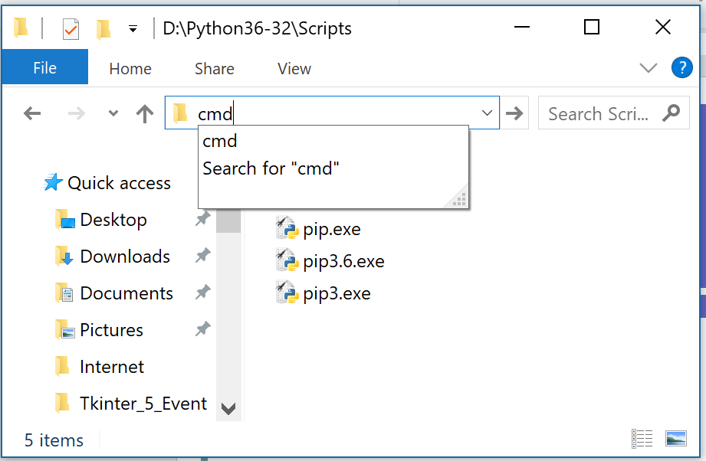
PIL
Installation 2017

Slide 4
PIL
Installation 2017
D:\Python36-32\Scripts>pip install pillow
from PIL import Image
import sys
print('Python version is ' + sys.version)
print('PIL version is ' + Image.VERSION)
print('PILLOW version is ' + Image.PILLOW_VERSION)
Python version is 3.6.2 (v3.6.2:5fd33b5, Jul 8 2017, 04:14:34) [MSC v.1900 32 bit (Intel)]
PIL version is 1.1.7
PILLOW version is 4.2.1

Slide 5
PIL
from PIL import Image
im = Image.open("C:\Windows\Web\Screen\img100.jpg")
print(im.format, im.size, im.mode)
JPEG (3840, 2160) RGB

Slide 6
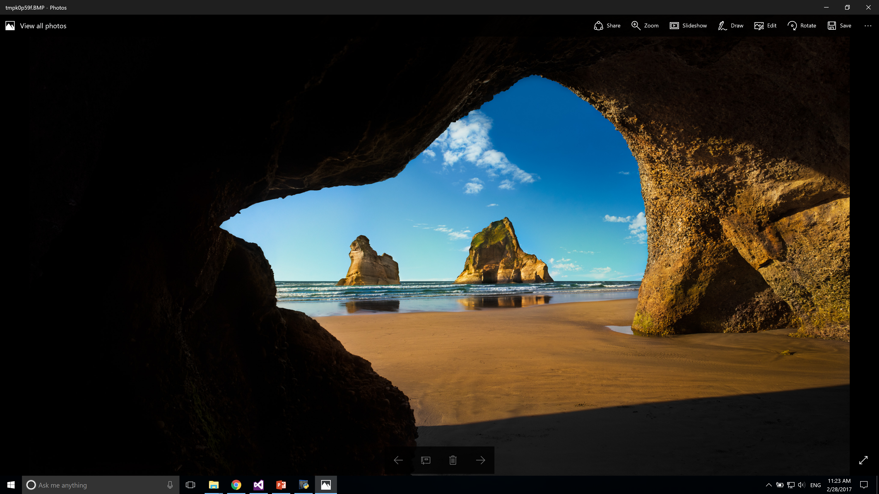
PIL
from PIL import Image
im = Image.open("C:\Windows\Web\Screen\img100.jpg")
im.show()

Slide 7
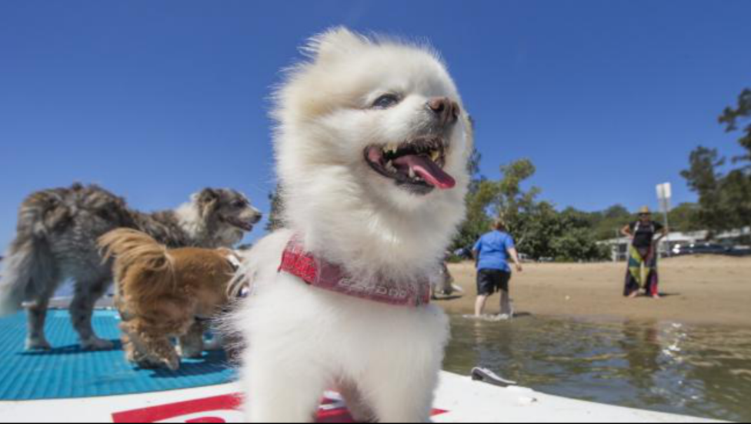
PIL
from PIL import Image
from urllib.request import urlopen
url = r'http://cdn.newsapi.com.au/image/v1/f146b7248639eed5ef3df978b9cb74b3'
im = Image.open(urlopen(url))
im.show()

Slide 8
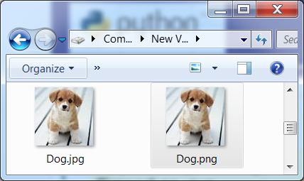
PIL
Convert files
from PIL import Image
Image.open("d:\Dog.jpg").save("d:\Dog.png")

Slide 9
PIL
Rotate an image
from PIL import Image
im = Image.open("C:\Windows\Web\Screen\img100.jpg")
out = im.resize((128, 128))
out.show()
out = im.transpose(Image.FLIP_LEFT_RIGHT)
out = im.transpose(Image.FLIP_TOP_BOTTOM)
out = im.transpose(Image.ROTATE_90)
out = im.transpose(Image.ROTATE_180)
out = im.transpose(Image.ROTATE_270)
out = im.transpose(Image.TRANSPOSE)

Slide 10
PIL
Open, rotate, and display an image (using the default viewer)
from PIL import Image
Image.open("d:\Dog.jpg").rotate(90).show()

Slide 11
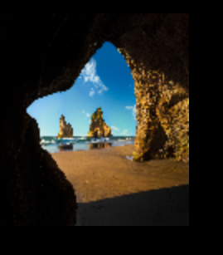
PIL
Resize an image
from PIL import Image
im = Image.open("C:\Windows\Web\Screen\img100.jpg")
out = im.resize((128, 128))
out.show()

Slide 12
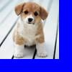
PIL
Paste a image into another
from PIL import Image
from PIL import ImageDraw
im = Image.new('RGB', (100,100), 'blue')
draw = ImageDraw.Draw(im)
img = Image.open(r'f:\Dog.jpg')
x, y = img.size
im.paste(img, (0,0,x,y))
im.show()
del draw
im.save(r'f:\test.jpg', 'JPEG')

Slide 13
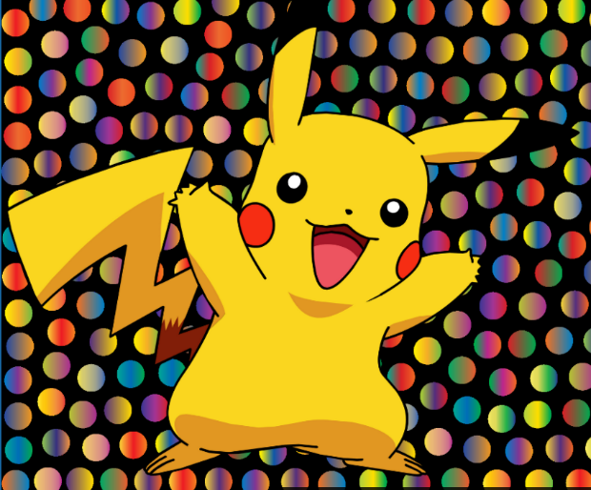
PIL
Paste a PNG image with transparency to another image
from PIL import Image
from PIL import ImageDraw
foreground = Image.open(r"f:\pikachu.png")
background = Image.open(r"f:\bg.png")
background.paste(foreground, (0, 0), foreground)
background.show()

Slide 14
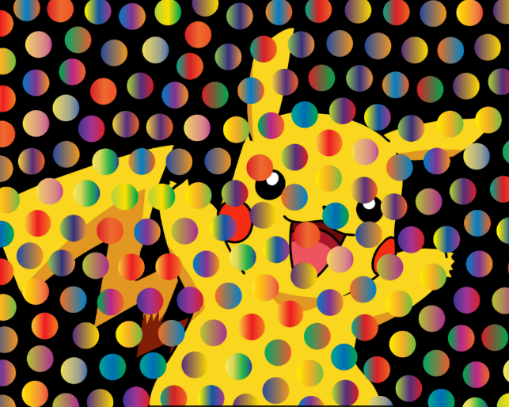
PIL
Paste a PNG image with transparency to another image
from PIL import Image
from PIL import ImageDraw
background = Image.open(r"f:\pikachu.png")
foreground = Image.open(r"f:\bg.png")
background.paste(foreground, (0, 0), foreground)
background.show()

Slide 15
PIL
Crop the image
from PIL import Image
im=Image.open("f:\")
area = (20,5,62,35)
cropped_img = im.crop(area)
cropped_img.show()
Dog.jpg
Cropped_img

Slide 16
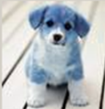
PIL
Splitting and merging bands
from PIL import Image
im=Image.open("d:\Dog.jpg")
im= im.convert('RGB')
r, g, b = im.split()
im = Image.merge("RGB", (b, g, r))
im.show()

Slide 17
PIL
Splitting and merging bands
from PIL import Image
im=Image.open("f:\mouse.pcx")
im= im.convert('RGB')
r, g, b = im.split()
#print (list(im.getdata()))
#print (list(r.getdata()))
r.convert("RGB").save("f:\\r.png")
g.convert("RGB").save("f:\\g.png")
b.convert("RGB").save("f:\\b.png")
im = Image.merge("RGB", (b, g, r))
im.show()

Slide 18
PIL
Filters
from PIL import Image, ImageFilter
im=Image.open("d:\Dog.jpg")
out = im.filter(ImageFilter.BLUR)
out.show()
BLUR, CONTOUR, DETAIL, EDGE_ENHANCE, EDGE_ENHANCE_MORE, EMBOSS, FIND_EDGES, SMOOTH, SMOOTH_MORE, SHARPEN.

Slide 19
PIL
Filters
from PIL import Image, ImageFilter
im=Image.open("d:\Dog.jpg")
out = im.filter(ImageFilter.GaussianBlur(radius=4))
out.show()
from PIL import Image, ImageFilter
im=Image.open(r'd:\Dog.jpg')
out = im.filter(ImageFilter.UnsharpMask(radius=20, percent=150, threshold=3))
out.save(r'f:\dog1.jpg', 'JPEG')
out.show()

Slide 20
PIL
The ImageDraw Module
from PIL import Image, ImageDraw
im = Image.open(r'f:\dog.jpg')
draw = ImageDraw.Draw(im)
draw.line((0, 0) + im.size, fill=128)
draw.line((0, im.size[1], im.size[0], 0), fill=128)
del draw
im.save(r'f:\dog.png')
Color

Slide 21
PIL
The ImageDraw Module
Transparent color
from PIL import Image, ImageDraw
image = Image.new("RGBA", (320,320), (0,0,0,0))
draw = ImageDraw.Draw(image)
draw.ellipse((10,10,300,300), fill="red", outline="red")
del draw
image.show()
image.save("d:\Circle.png", "PNG")
Transparent color

Slide 22
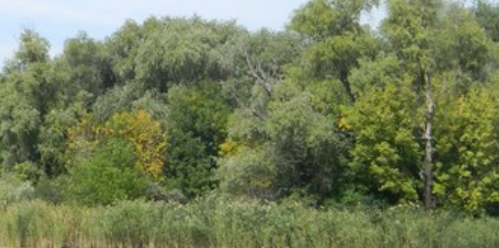
PIL
The ImageGrab Module
The ImageGrab module can be used to copy the contents of the screen or the clipboard to a PIL image memory.
from PIL import Image, ImageGrab
im = ImageGrab.grab()
im.show()
im.save("d:\clip.png")

Slide 23
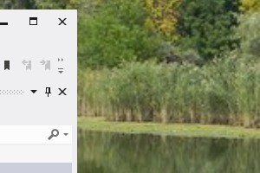
PIL
The ImageGrab Module
from PIL import Image, ImageGrab
bbox=(900,500,1200,700)
im = ImageGrab.grab(bbox)
im.show()
im.save("d:\clip.png")

Slide 24
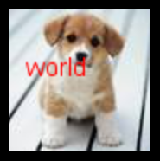
PIL
The ImageFont Module
from PIL import Image, ImageFont, ImageDraw
image = Image.open("f:\dog.jpg")
draw = ImageDraw.Draw(image)
# use a truetype font
font = ImageFont.truetype("arial.ttf", 15)
draw.text((10, 25), "world", font=font,fill="red")
image.show()

Slide 25
PIL
Enhancement. שיפור.
from PIL import Image, ImageEnhance
im=Image.open("d:\Dog.jpg")
enh = ImageEnhance.Contrast(im)
#enh = ImageEnhance.Brightness(im)
enh.enhance(1.3).show("30% more Contrast")
#im.show()

Slide 26
PIL
Point Operations
image contrast manipulation
from PIL import Image, ImageFilter
im=Image.open("d:\Dog.jpg")
# multiply each pixel by 1.8 out = im.point(lambda i: i * 1.8)
out = im.point(lambda i: i * 1.8)
out.show()

Slide 27
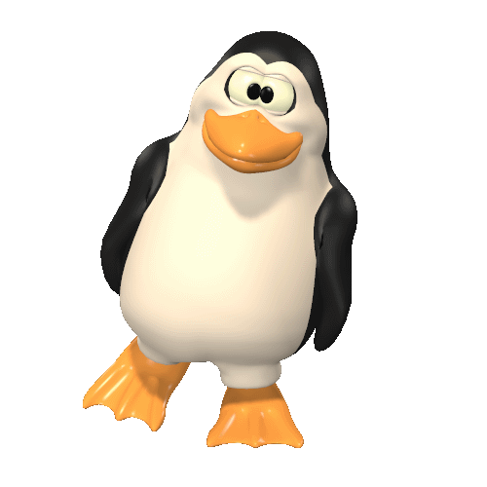
PIL
Image Sequences (Animation)
PIL reads GIF87a and GIF89a versions of the GIF file format.

Slide 28
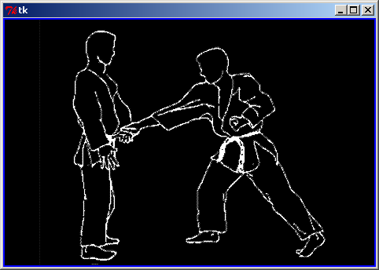
PIL
Image Sequences (Animation)
PIL reads GIF87a and GIF89a versions of the GIF file format.

Slide 29
PIL
from tkinter import *
from PIL import Image, ImageDraw, ImageTk
import time
root = Tk()
lbl1=Label(root,width=470, height=313, text="The Image",bg="blue",fg="yellow")
lbl1.pack()
im=Image.open("d:\\jun_kata.gif")
im.seek(1)
try:
while 1:
newPhotoImg=ImageTk.PhotoImage(im)
lbl1["image"]=newPhotoImg
if im.tell()+1<5:
im.seek(im.tell()+1)
else:
im=Image.open("d:\\jun_kata.gif")
im.seek(1)
lbl1.update()
time.sleep(0.5)
except EOFError:
pass
root.mainloop()

Slide 30
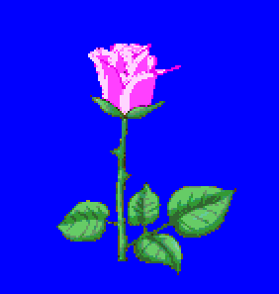
PIL
from tkinter import *
from PIL import Image, ImageDraw, ImageTk
import time
root = Tk()
lbl1=Label(root,width=470, height=313, text="The Image",bg="blue",fg="yellow")
lbl1.pack()
im=Image.open("d:\\Rose.gif")
im.seek(1)
try:
while 1:
newPhotoImg=ImageTk.PhotoImage(im)
lbl1["image"]=newPhotoImg
if im.tell()+1<5:
im.seek(im.tell()+1)
else:
im=Image.open("d:\\Rose.gif")
im.seek(1)
lbl1.update()
time.sleep(0.5)
except EOFError:
pass
root.mainloop()

