Slide 1
Microsoft Registry Editor
Remove shortcut arrow from desktop icons completely
arrow

Slide 2
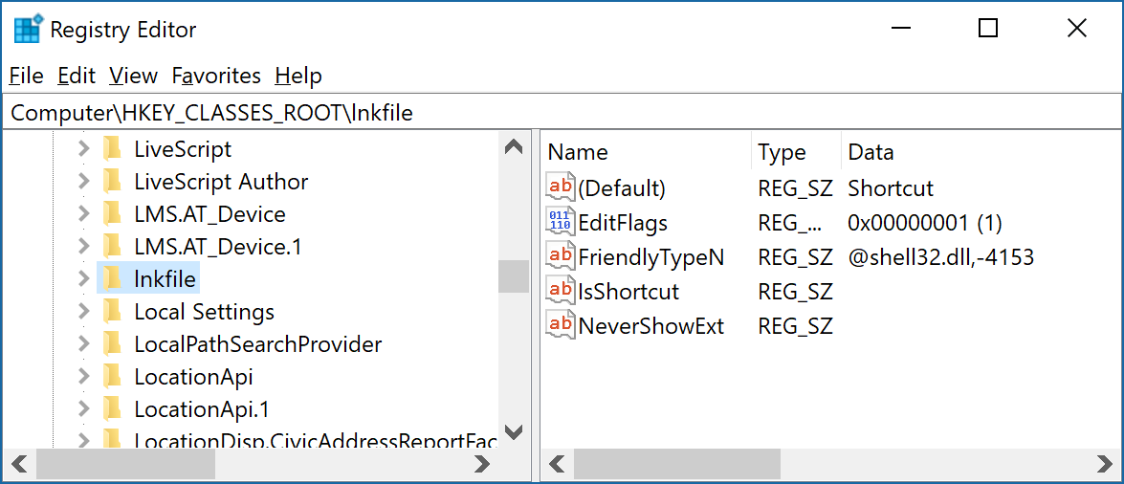
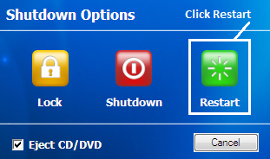
Microsoft Registry Editor
Remove shortcut arrow from desktop icons completely
delete

Slide 3
Microsoft Registry Editor
Remove shortcut arrow from desktop icons completely
Arrow ???

