Slide 1


הצגת פרויקט גמר במגשימים

Slide 2

Agenda
01
What is Drop Shipping ?
02
About My Project
03
Project Services
04
Preview

Slide 3
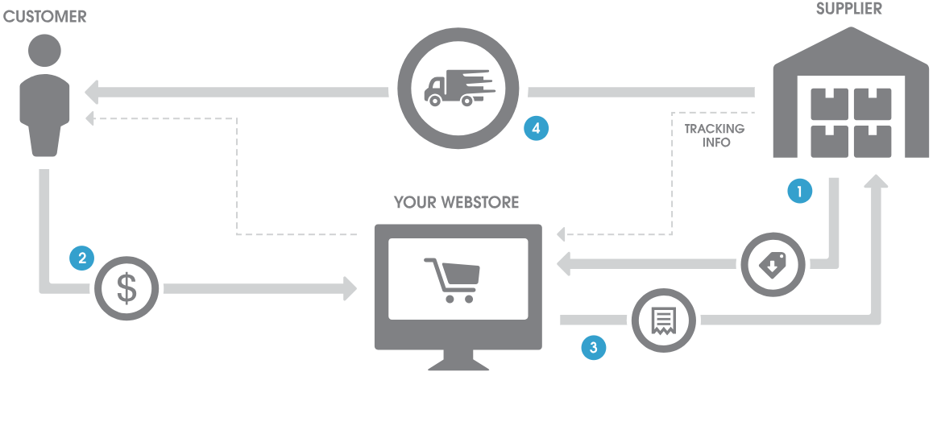

Drop Shipping
How It Works ?

Slide 4

An online tool that will help promote eBay sales with the help of a market investigation, which allows scanning sellers and products on eBay.
The site collects a wide range of statistics on other users' stores so that we can see for example what products we sell best, and also product research that gives us the exact statistics and information on the level of demand, competition and success rates to know which products are "hot" On eBay.
The target audience of the tool is all the people who trade in eBay using the Drop Shipping method, who want to increase their sales and profits.
About
The Project

Slide 5

Project Services
Scan Products
Scan Sellers
Save Sellers
Research niches and products to know what the hottest products on eBay.
You can research and get full information about sellers on eBay.
You can save names of sellers, and research them in the future.
Finding competitors
Item Finder
Responsive
Finds people who sell your products, helping you to be the strongest in the market
A unique tool that allows us to find the product at the large suppliers like Amazon.
Explore everywhere with support for all types of devices!

Slide 6
Any Questions?

Slide 7
Preview

