Slide 1
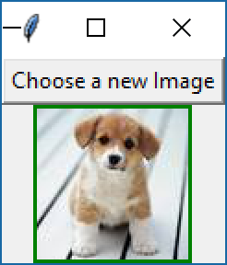
PIL
Open File

Slide 2
PIL
Open File
from tkinter import *
from PIL import Image, ImageDraw, ImageTk
root = Tk()
root.title("Image Editor")
def ChooseImage():
NewFile=root.call("tk_getOpenFile",'-initialdir','c:\\','-title', 'Choose an Image')
image = Image.open(NewFile)
global NewImage
NewImage=ImageTk.PhotoImage(image)
lbl1["image"]=NewImage
btn1=Button(root, text='Choose a new Image', command=ChooseImage)
lbl1 = Label(root, bg='green')#,image=NewImage)
btn1.pack()
lbl1.pack()
root.mainloop()

Slide 3
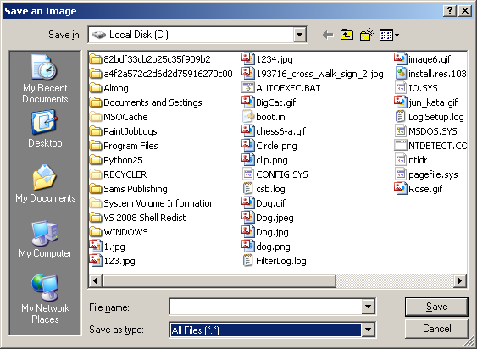
PIL
Save File

Slide 4
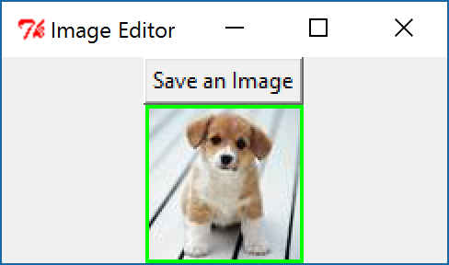
PIL
Save File

Slide 5
PIL
Save File
from tkinter import *
from PIL import Image, ImageDraw, ImageTk
tk = Tk()
tk.title("Image Editor")
def SaveImage():
name=tk.call("tk_getSaveFile",'-initialdir','d:\\','-title', 'Save an Image','-defaultextension','jpg')
image.save(name)
btn1=Button(tk, text='Save an Image', command=SaveImage)
image = Image.open("f:\dog.jpg")
NewImage=ImageTk.PhotoImage(image)
lbl1 = Label(tk, bg='green',image=NewImage)
btn1.pack()
lbl1.pack()
tk.mainloop()

