Slide 1

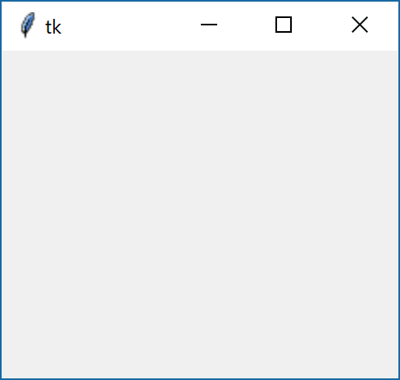
Tkinter
Tkinter is a GUI (graphical user interface) widget set for Python.
The Tkinter module (“ToolKit interface”) is the standard Python interface to the Tk GUI toolkit.
import tkinter as tk
#To initialize Tkinter, we have to create a Tk root widget.
root = tk.Tk()
#The program will stay in the event loop until we close the window.
tk.mainloop()

Slide 2
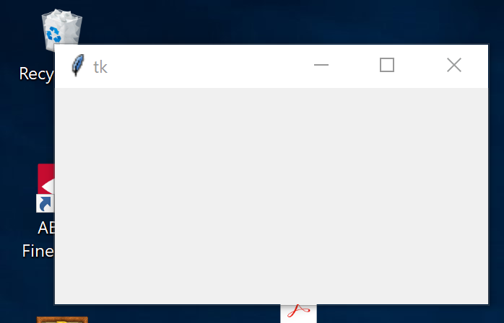
Tkinter
geometry()
The geometry() method sets a size for the window and positions it on the screen
import tkinter as tk
root = tk.Tk()
root.geometry("300x150+30+30") # Size: 300x150, Loc: 30,30
tk.mainloop()
30x30
300
150

Slide 3
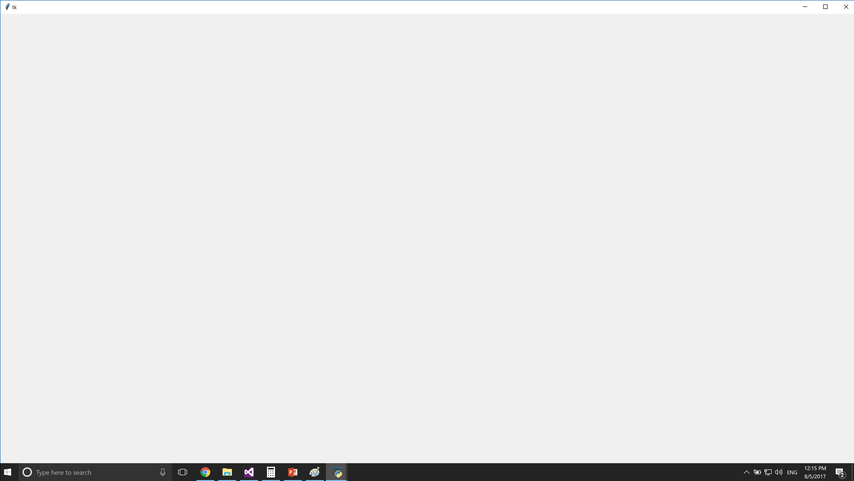
Tkinter
Full screen
import tkinter as tk
root = tk.Tk()
x = root.winfo_screenwidth()
y = root.winfo_screenheight()
root.geometry("%dx%d" % (x,y))
tk.mainloop()

Slide 4

Tkinter
No title bar and window buttons, plus no borders
import tkinter as tk
root = tk.Tk()
root.overrideredirect(1)
tk.mainloop()

Slide 5
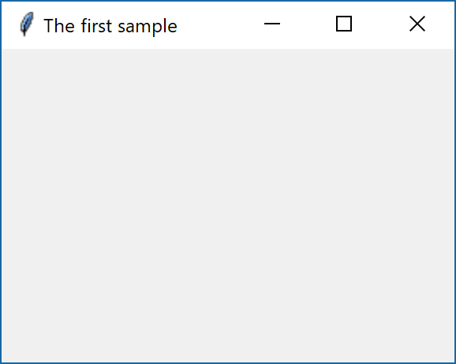
Tkinter
Title
import tkinter as tk
root = tk.Tk()
root.title("The first sample")
tk.mainloop()

Slide 6
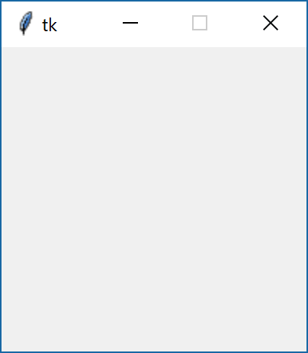
Tkinter
Resizable()
import tkinter as tk
root = tk.Tk()
root.resizable(width=tk.FALSE, height=tk.FALSE)
tk.mainloop()

Slide 7
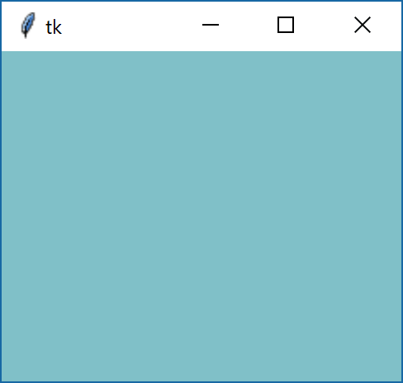
Tkinter
background
import tkinter as tk
root = tk.Tk()
tk_rgb = "#%02x%02x%02x" % (128, 192, 200)
root["background"]=tk_rgb
tk.mainloop()

Slide 8
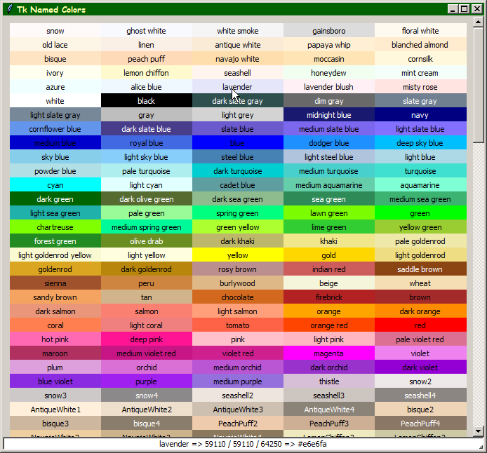
Tkinter

Slide 9
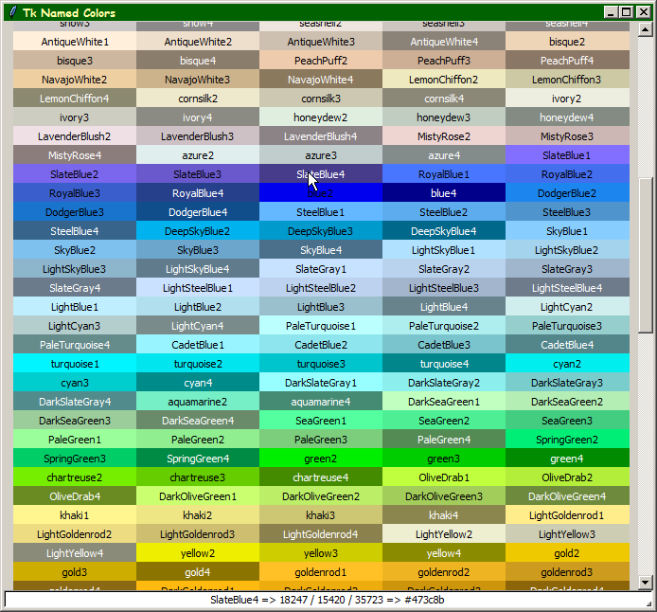
Tkinter

Slide 10
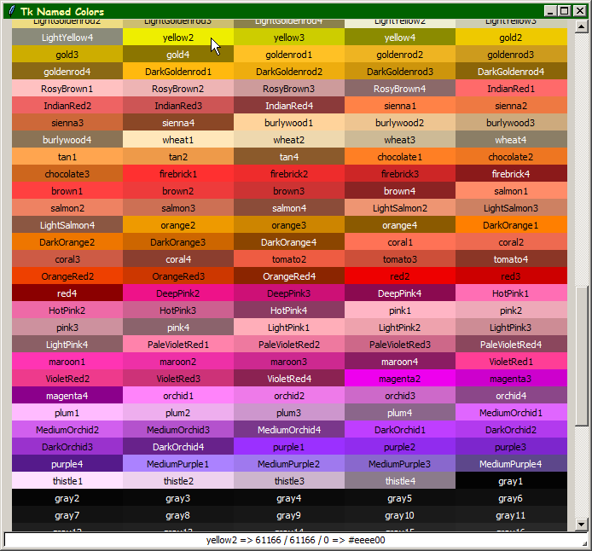
Tkinter

Slide 11
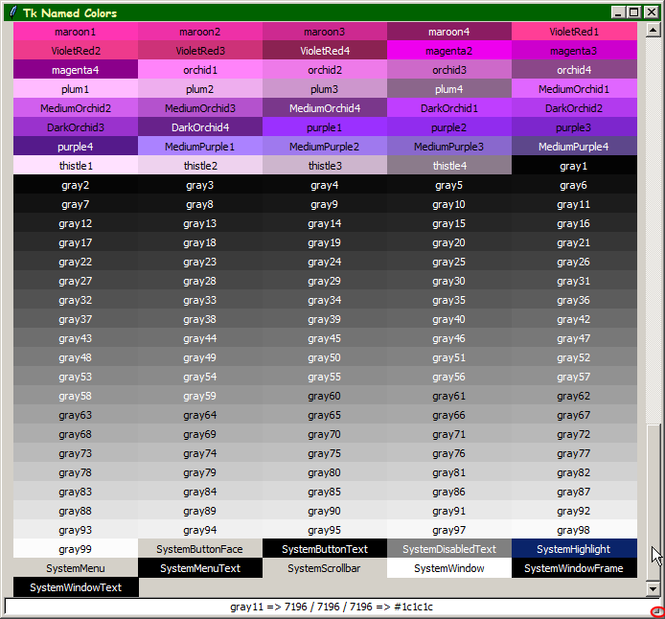
Tkinter

Slide 12
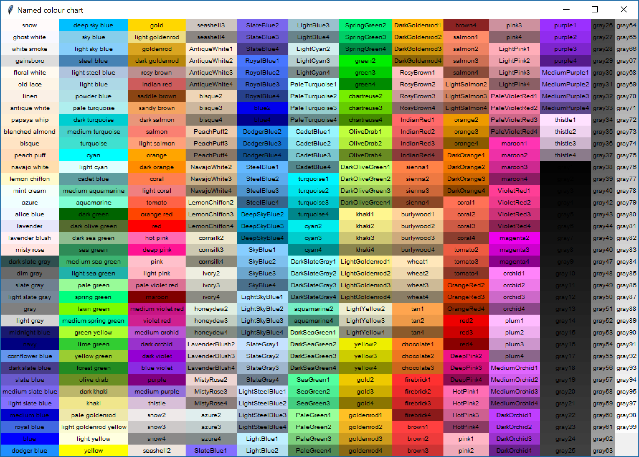
Tkinter

Slide 13
Tkinter
from tkinter import *
MAX_ROWS = 36
FONT_SIZE = 10 # (pixels)
COLORS = ['snow', 'ghost white', 'white smoke', 'gainsboro', 'floral white', 'old lace',
'linen', 'antique white', 'papaya whip', 'blanched almond', 'bisque', 'peach puff',
. . .
root = Tk()
root.title("Named colour chart")
row = 0
col = 0
for color in COLORS:
e = Label(root, text=color, background=color,
font=(None, -FONT_SIZE))
e.grid(row=row, column=col, sticky=E+W)
row += 1
if (row > 36):
row = 0
col += 1
root.mainloop()

Slide 14
Tkinter
Windows Attributes
Most options take a true/false value
-alpha double
  how opaque the overall window is; note that changing between 1.0 and any other value may cause the window to flash.
-fullscreen boolean
  controls whether the window fills the whole screen, including taskbar
-disabled boolean
  makes it impossible to interact with the window and redraws the focus
-toolwindow boolean
  makes a window with a single close-button (which is smaller than usual) on the right of the title bar
-topmost boolean
  makes sure the window always stays on top of all other windows

Slide 15
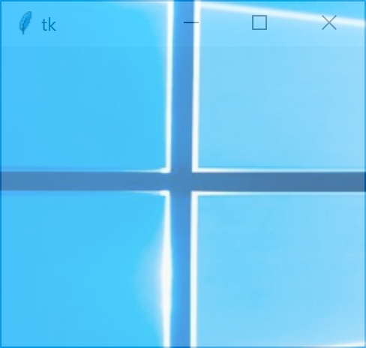
Tkinter
Transparency
import tkinter as tk
root = tk.Tk()
# use transparency level 0.1 to 1.0 (no transparency)
root.attributes("-alpha", 0.3)
tk.mainloop()

Slide 16

Tkinter
Fullscreen
import tkinter as tk
root = tk.Tk()
root.attributes("-fullscreen", True)
tk.mainloop()

