Slide 1
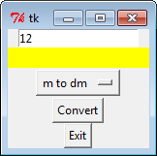
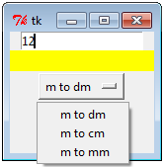
Tkinter
OptionMenu

Slide 2
Tkinter
from tkinter import *
root=Tk()
def convert():
if (strChoose.get()=="m to dm"):
lb1["text"]=int(inputNumber.get())*10
if (strChoose.get()=="m to cm"):
lb1["text"]=int(inputNumber.get())*100
if (strChoose.get()=="m to mm"):
lb1["text"]=int(inputNumber.get())*1000
continue

Slide 3
Tkinter
inputNumber=Entry(root, text="Enter number")
inputNumber.pack()
lb1=Label(root,bg="yellow", width=20)
lb1.pack()
strChoose =StringVar()
strChoose.set("m to dm")
convert_choose=OptionMenu(root,strChoose,
"m to dm",
"m to cm",
"m to mm")
ConvertChoose.pack()
rbt1=Button(root,text="Convert",command=convert)
rbt1.pack()
rbt1=Button(root,text="Exit",command=exit)
rbt1.pack()
root.mainloop()
The end

