Slide 1

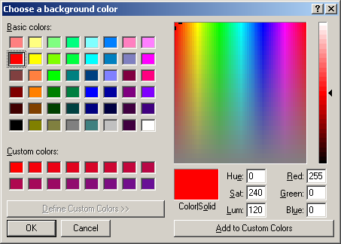
Tkinter
Choose Color

Slide 2
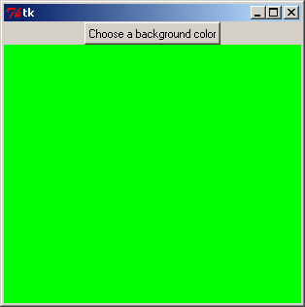
Tkinter
Choose Color

Slide 3
Tkinter
Choose Color
from tkinter import *
root = Tk()
def ChooseColor():
new_color=root.call("tk_chooseColor",'-initialcolor','RED','-title', 'Choose a background color')
lbl1["bg"]=new_color
lbl1 = Label(root, bg='green',width=50, height=20)
btn1=Button(root, text='Choose a background color', command=ChooseColor)
btn1.pack()
lbl1.pack()
root.mainloop()
NewColor=root.call("tk_chooseColor”)

Slide 4
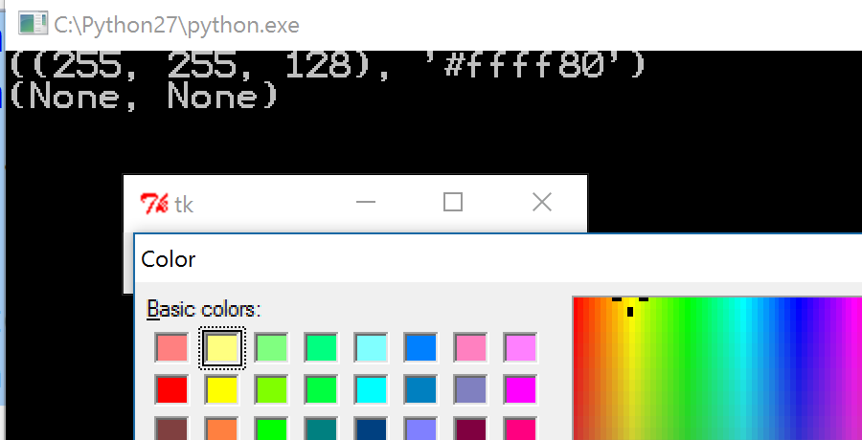
Tkinter
Choose Color
Version 2
from tkinter import *
from tkinter.colorchooser import *
root = Tk()
def getColor():
color = askcolor()
print (color)
Button(root,text='Select Color', command=getColor).pack()
mainloop()

Slide 5
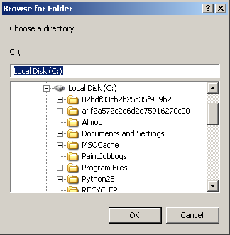
Tkinter
Choose Directory

Slide 6
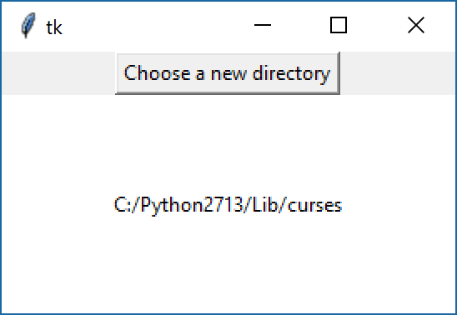
Tkinter
Choose Directory

Slide 7
Tkinter
Choose Directory
from tkinter import *
root = Tk()
def ChooseDir():
new_directory=root.call("tk_chooseDirectory",'-initialdir','c:\\','-title', 'Choose a directory')
lbl1["text"]=new_directory
lbl1 = Label(root, bg='white',width=50, height=20)
btn1=Button(root, text='Choose a new directory', command=ChooseDir)
btn1.pack()
lbl1.pack()
root.mainloop()
new_directory=tk.call("tk_chooseDirectory”)

Slide 8
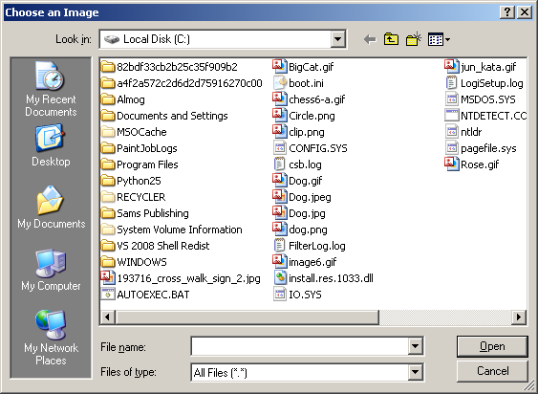
Tkinter
Open File

Slide 9
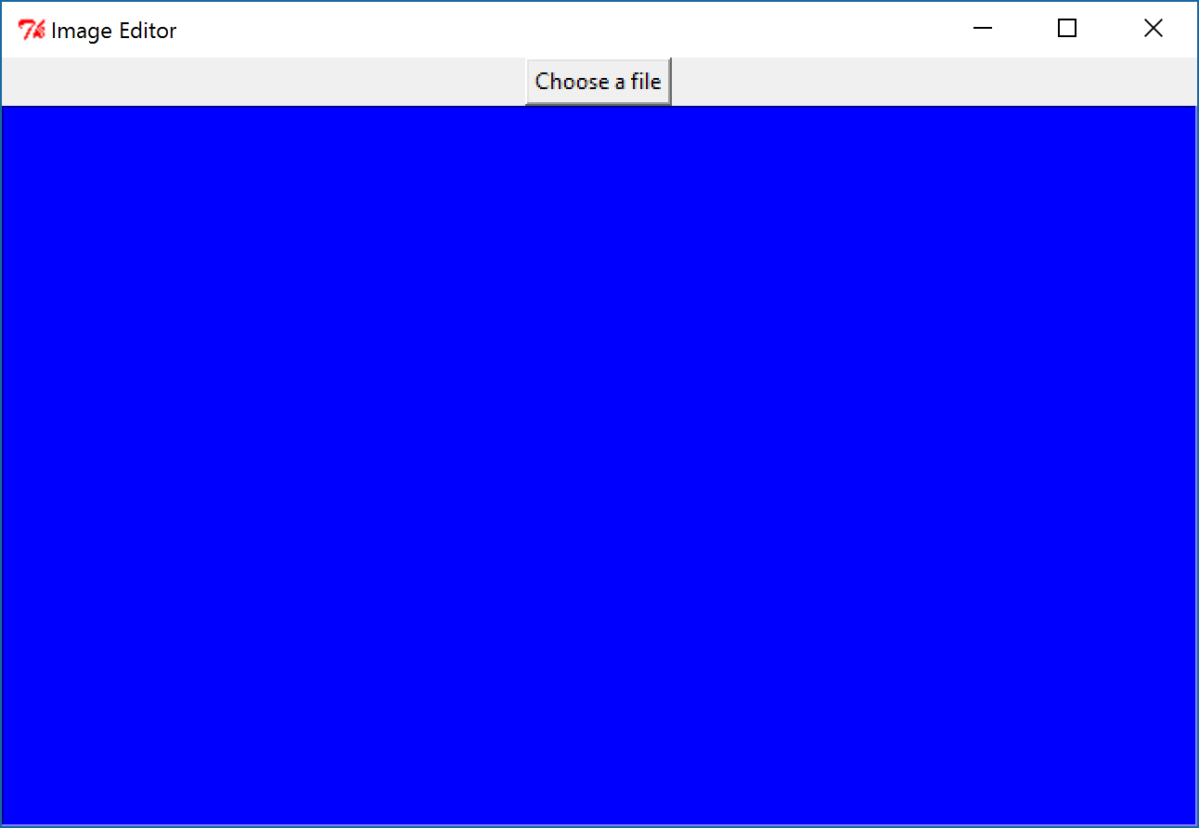
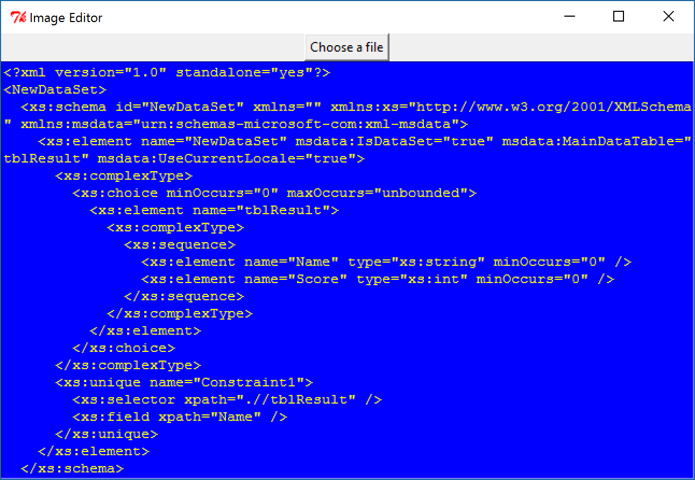
Tkinter
Open File

Slide 10
Tkinter
Open File
from tkinter import *
root = Tk()
root.title('Text viewer')
def OpenFile():
file=root.call("tk_getOpenFile",'-initialdir','c:\\','-title', 'Open a file')
f = open(file,'r')
txt.insert(INSERT,f.read())
btn=Button(root, text='Open a file', command=OpenFile)
txt = Text(root, bg='blue', fg='yellow')
btn.pack()
txt.pack()
root.mainloop()

Slide 11
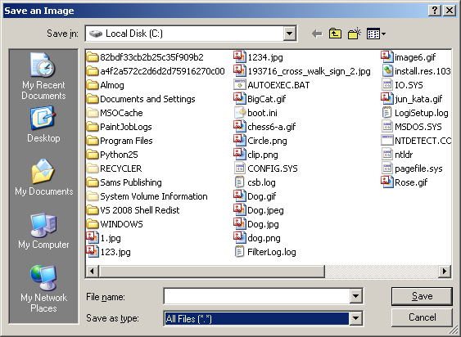
Tkinter
Save File

Slide 12
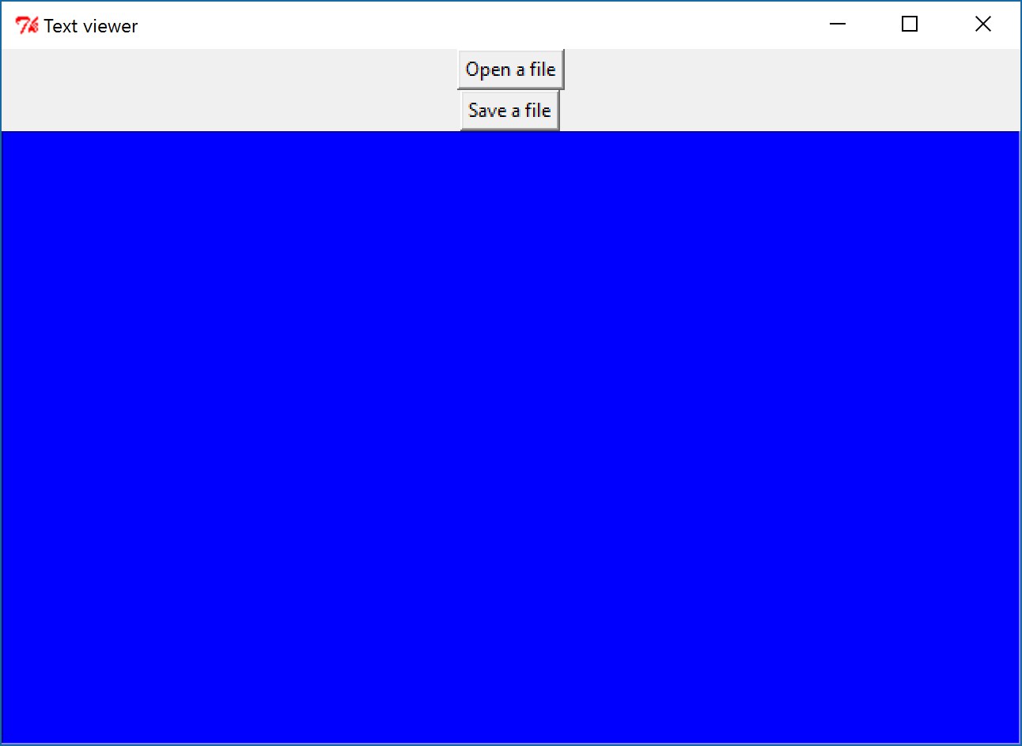
Tkinter
Save File

Slide 13
Tkinter
Save File
from tkinter import *
root = Tk()
root.title("Text viewer")
def open_file():
file=root.call("tk_getOpenFile",'-initialdir','c:\\','-title', 'Open a file')
f = open(file,'r')
txt.insert(INSERT,f.read())
def save_file():
file=root.call("tk_getSaveFile",'-initialdir','c:\\','-title', 'Save a file')
f = open(file,'w')
f.write(txt.get("1.0",END))
f.close()
btn_open=Button(root, text='Open a file', command=open_file)
btn_save=Button(root, text='Save a file', command=save_file)
txt = Text(root, bg='blue', fg='yellow')
btn_open.pack()
btn_save.pack()
txt.pack()
root.mainloop()

Slide 14
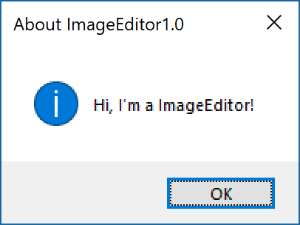
Tkinter
Message box
from tkinter import *
from tkinter.messagebox import *
tk = Tk()
showinfo("About ImageEditor1.0","Hi, I'm a ImageEditor!")
tk.mainloop()

Slide 15
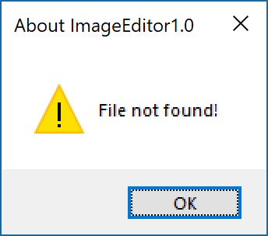
Tkinter
Message box
from tkinter import *
from tkinter.messagebox import *
tk = Tk()
showwarning("About ImageEditor1.0","File not found!")
tk.mainloop()

Slide 16
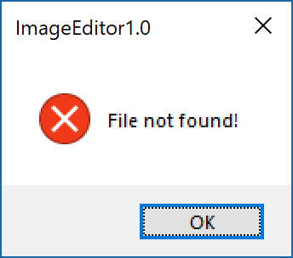
Tkinter
Message box
from tkinter import *
from tkinter.messagebox import *
tk = Tk()
showerror ("ImageEditor1.0","File not found!")
tk.mainloop()

Slide 17
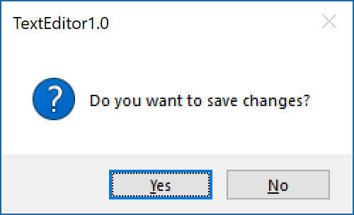
Tkinter
Message box

Slide 18
Tkinter
Message box
from tkinter import *
from tkinter.messagebox import *
def save_file():
result=askyesno("TextEditor1.0","Do you want to save changes?")
if (result==1):
file=root.call("tk_getSaveFile",'-initialdir','c:\\','-title', 'Save a file')
f = open(file,'w')
f.write(txt.get("1.0",END))
f.close()
tk = Tk()
save_file()
tk.mainloop()

Slide 19
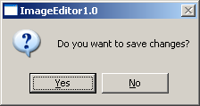
Tkinter
Message box
result = askquestion("ImageEditor1.0","Do you want to save changes?")
if (result=="yes"):

Slide 20
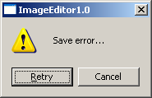
Tkinter
Message box
result = askretrycancel( "ImageEditor1.0","Save error...")
if (result==1):

Slide 21
Tkinter
File Dialog
from tkinter import *
from tkinter.filedialog import *
import winsound
def Play():
MusicFileName = askopenfilename(filetypes=[("Music files","wav")])
winsound.PlaySound(MusicFileName,winsound.SND_FILENAME | winsound.SND_ASYNC | winsound.SND_NOWAIT)
tk = Tk()
btn1=Button(tk, text='Play', command=Play)
btn1.pack()
tk.mainloop()

Slide 22
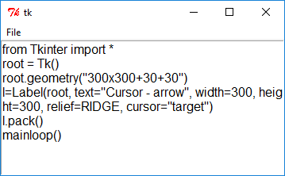
Tkinter
from tkinter import *
from tkinter.filedialog import *
import fileinput
def _open():
op = askopenfilename()
for l in fileinput.input(op):
txt.insert(END,l)
root = Tk()
m = Menu(root)
root.config(menu=m)
fm = Menu(m)
m.add_cascade(label="File",menu=fm)
fm.add_command(label="Open...",command=_open)
txt = Text(root,width=40,height=15,font="12")
txt.pack()
root.mainloop()

