Slide 1
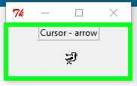
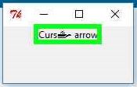
Tkinter
Cursor
from tkinter import *
root= Tk()
root['cursor']='gobbler'
l=Label(root,text='Cursor - arrow', relief=RIDGE, cursor='boat')
l.pack()
root.mainloop()

Slide 2
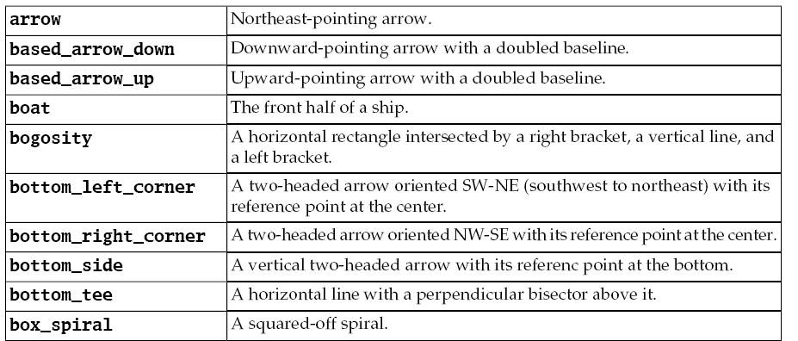
Tkinter

Slide 3
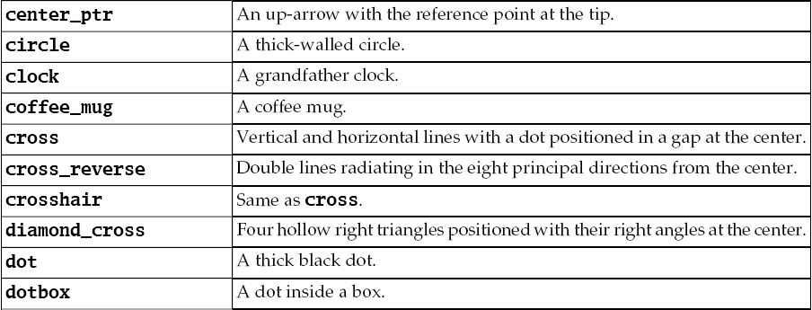
Tkinter

Slide 4
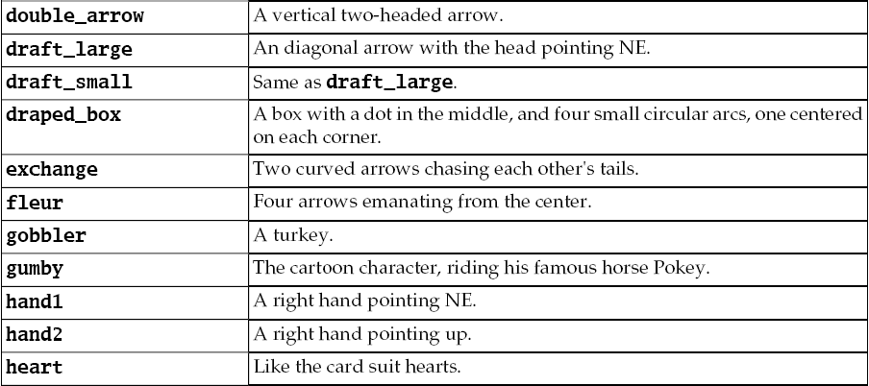
Tkinter

Slide 5
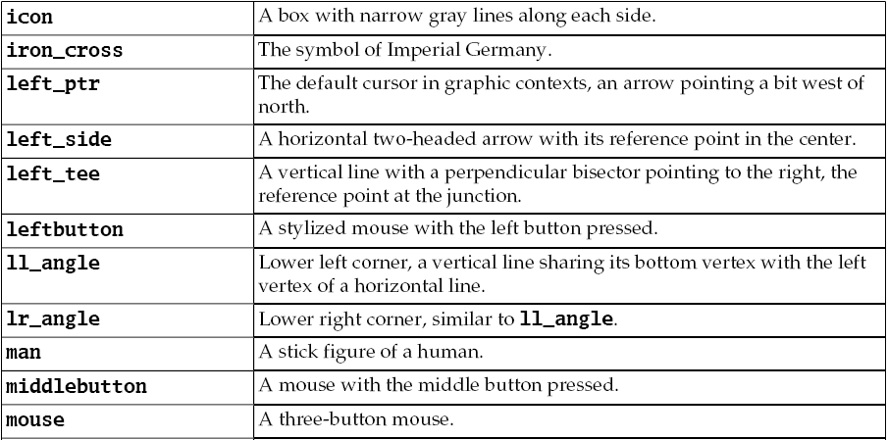
Tkinter

Slide 6
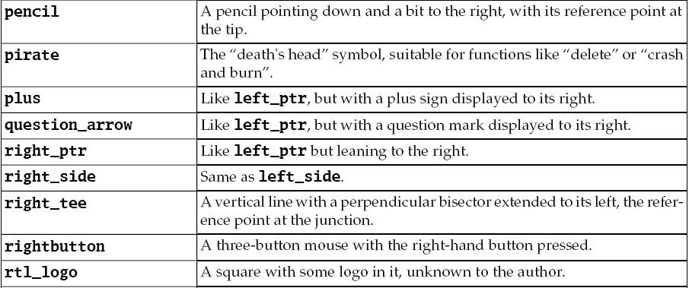
Tkinter

Slide 7
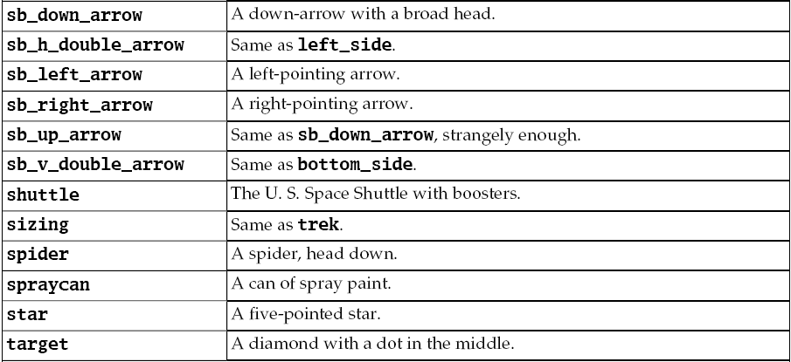
Tkinter

Slide 8
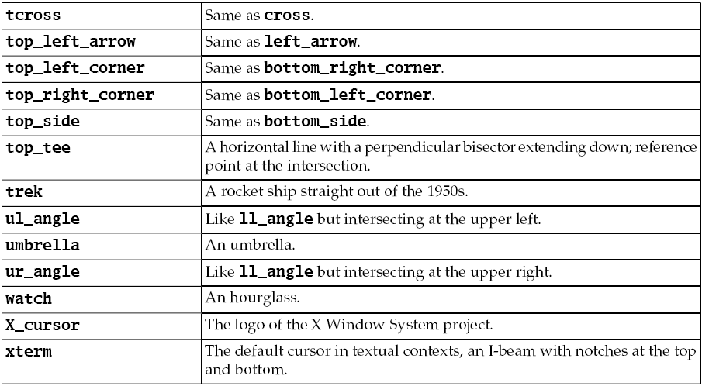
Tkinter

Slide 9
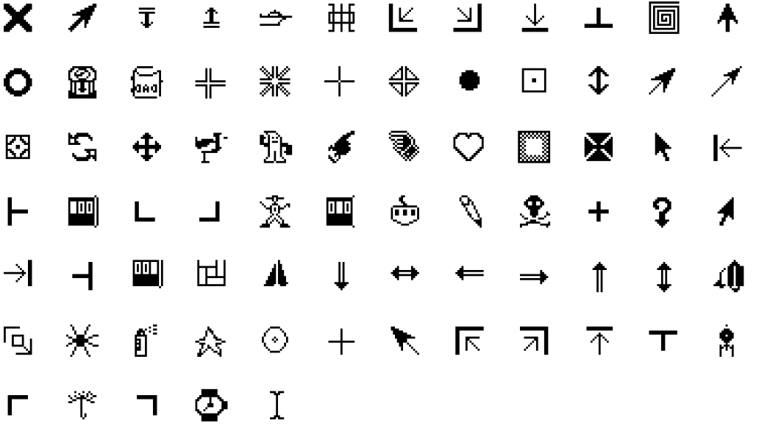
Tkinter

Slide 10
Tkinter
"""
Code illustration: 9.01
Demo of Available Cursors
Tkinter GUI Application Development Hotshot
"""
from tkinter import *
all_cursors = ['X_cursor' , 'arrow' , 'based_arrow_down' , 'based_arrow_up' ,
'boat' , 'bogosity' , 'bottom_left_corner' , 'bottom_right_corner' ,
'bottom_side' , 'bottom_tee' , 'box_spiral' , 'center_ptr' , 'circle' ,
'clock' , 'coffee_mug' , 'cross' , 'cross_reverse' , 'crosshair' ,
'diamond_cross' , 'dot' , 'dotbox' , 'double_arrow' , 'draft_large',
'draft_small' , 'draped_box' , 'exchange' , 'fleur' , 'gobbler' ,
'gumby' , 'hand1' , 'hand2' , 'heart' , 'icon' , 'iron_cross' ,
'left_ptr' , 'left_side' , 'left_tee' , 'leftbutton' , 'll_angle' ,
'lr_angle' , 'man' , 'middlebutton' , 'mouse' , 'pencil' , 'pirate' ,
'plus' , 'question_arrow' , 'right_ptr' , 'right_side' , 'right_tee' ,
'rightbutton' , 'rtl_logo' , 'sailboat' , 'sb_down_arrow' ,
'sb_h_double_arrow' , 'sb_left_arrow' , 'sb_right_arrow' ,
'sb_up_arrow' , 'sb_v_double_arrow' , 'shuttle' , 'sizing' ,
'spider' , 'spraycan' , 'star' , 'target' , 'tcross' ,
'top_left_arrow' , 'top_left_corner' , 'top_right_corner' ,
'top_side' , 'top_tee' , 'trek' , 'ul_angle' , 'umbrella' ,
'ur_angle' , 'watch' , 'xterm']
root= Tk()
root.title('Hover Over White Area for Cursor Sample')
for i, item in enumerate(all_cursors):
r, c = i % 10, i // 10 * 2
Label(text=item).grid(row=r, column=c)
Label(width=3, height=3, cursor=item, bg='white').grid(row=r, column=c+1)
root.mainloop()

Slide 11
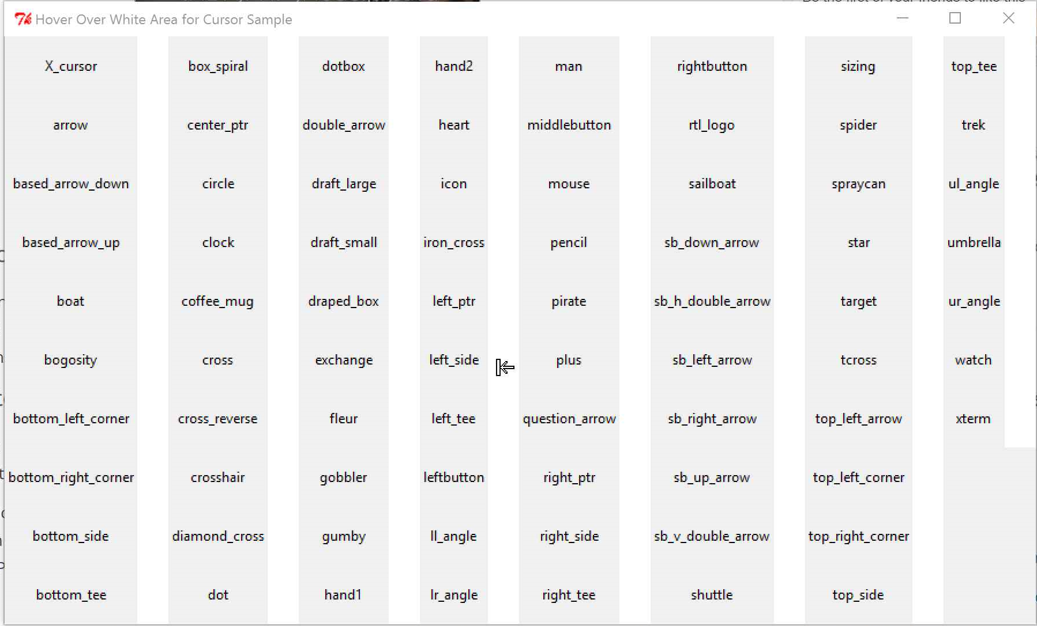
Tkinter

