Slide 1
Tkinter
Checkbutton
from tkinter import *
root=Tk()
Flag1 =BooleanVar()
def convert():
if (Flag1.get()):
lb1["text"]=int(textBox.get())*100
else:
lb1["text"]=int(textBox.get())/100.0
textBox=Entry(root, width=20)
textBox.pack()
lb1=Label(root,bg="yellow", width=20)
lb1.pack()
bt1=Button(root,text="Convert",command=convert)
bt1.pack()
Flag1.set(1)
ck1=Checkbutton(root, text="m to mm", variable=Flag1)
ck1.pack()
root.mainloop()

Slide 2
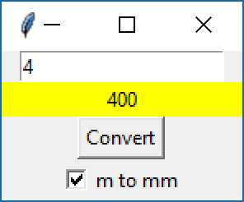
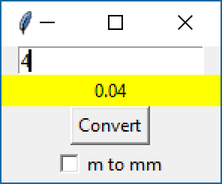
Tkinter
Checkbutton

