Slide 1



















SQLite
SQLite is a software library that implements a self-contained, serverless, zero-configuration, transactional SQL database engine. SQLite is the most widely deployed SQL database engine in the world. The source code for SQLite is in the public domain.

Slide 2
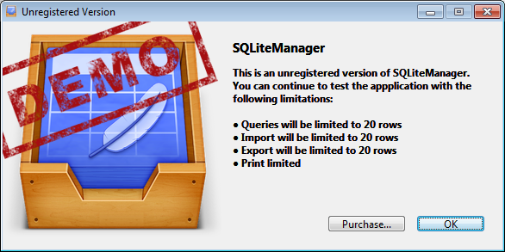
SQLite
SQLite Python tutorial:
http://zetcode.com/db/sqlitepythontutorial/
SQLite Manager

Slide 3
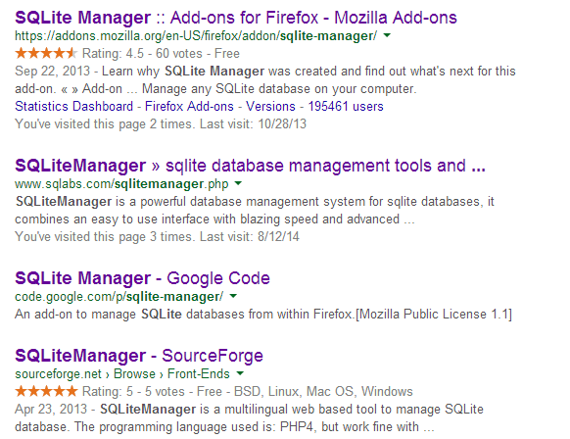
SQLite

Slide 4
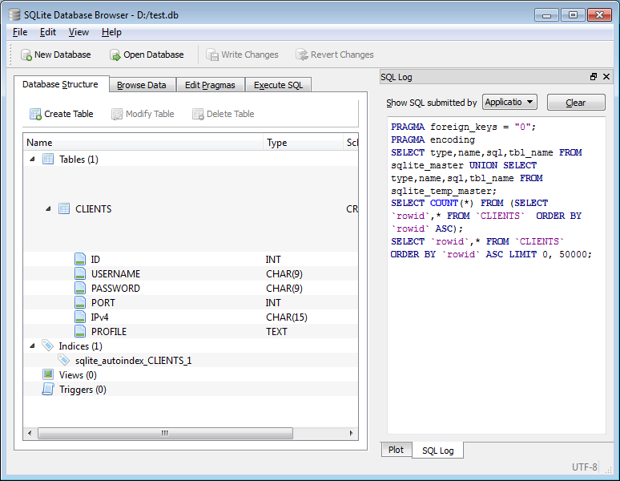
SQLite
SQLite Database Browser

Slide 5
SQLite
Create a Database
import sqlite3 as lite
import sys
conn = None
file_name='d:\\test.db'
try:
conn = lite.connect(file_name)
except lite.Error, e:
print "Error %s:" % file_name
sys.exit(1)
finally:
if conn:
print "Opened database successfully";
conn.close()
print "Closed database...";
Lite is a variant spelling of "light"

Slide 6
SQLite
Connecting To Database
import sqlite3 as lite
import sys
conn = None
file_name='d:\\test.db'
try:
conn = lite.connect(file_name)
except lite.Error, e:
print "Error %s:" % file_name
sys.exit(1)
finally:
if conn:
print "Opened database successfully";
conn.close()
print "Closed database...";

Slide 7
SQLite
Create a Table
. . .
def create_table(name):
try:
create_str='''CREATE TABLE %s (ID INT PRIMARY KEY NOT NULL,
USERNAME CHAR(9) NOT NULL,
PASSWORD CHAR(9) NOT NULL,
PORT INT NOT NULL,
IPv4 CHAR(15) NOT NULL,
PROFILE TEXT NULL
);'''%name
conn.execute(create_str)
print "Table created successfully";
except lite.Error, e:
print "Error create table %s:" % file_name
sys.exit(1)

Slide 8
SQLite
Create a Table
. . .
# Get all available tables in the current database
cur = conn.cursor()
cur.execute("SELECT name FROM sqlite_master WHERE type='table'")
rows = cur.fetchall()
if rows==[]:
create_table(table_name)
for row in rows:
if row[0] != table_name:
create_table(table_name)

Slide 9
SQLite
INSERT Operation
. . .
# Insert to database
conn.execute("INSERT INTO CLIENTS (ID,USERNAME,PASSWORD,PORT,IPv4) \
VALUES (1, 'Paul', 12345, 2000, '196.234.123.123')");
conn.execute("INSERT INTO CLIENTS (ID,USERNAME,PASSWORD,PORT,IPv4) \
VALUES (2, 'User', 12346, 2001, '196.234.100.23')");
conn.execute("INSERT INTO CLIENTS (ID,USERNAME,PASSWORD,PORT,IPv4) \
VALUES (3, 'Gamer', 123445, 2023, '196.34.23.13')");
conn.execute("INSERT INTO CLIENTS (ID,USERNAME,PASSWORD,PORT,IPv4) \
VALUES (4, 'User1', 4355, 3000, '190.24.23.23')");
conn.execute("INSERT INTO CLIENTS (ID,USERNAME,PASSWORD,PORT,IPv4) \
VALUES (5, 'ClientNew', 3465, 5000, '116.134.223.0')");
conn.commit()
print "Records created successfully";

Slide 10
SQLite
SELECT Operation
cursor = conn.execute("SELECT ID, USERNAME, PASSWORD, PORT, IPv4, PROFILE from CLIENTS")
for row in cursor:
print "ID = ", row[0]
print "USERNAME = ", row[1]
print "PASSWORD = ", row[2]
print "PORT = ", row[3]
print "IPv4 = ", row[4]
print "PROFILE = ", row[5], "\n"
print "Operation done successfully";

Slide 11
SQLite
UPDATE Operation
# Update database
conn.execute("UPDATE %s set PROFILE = 'Beginner' where ID=3"%table_name)
conn.commit()

Slide 12
SQLite
DELETE Operation
# Delete from database
conn.execute("DELETE from CLIENTS where ID==2;")
conn.commit()

Slide 13
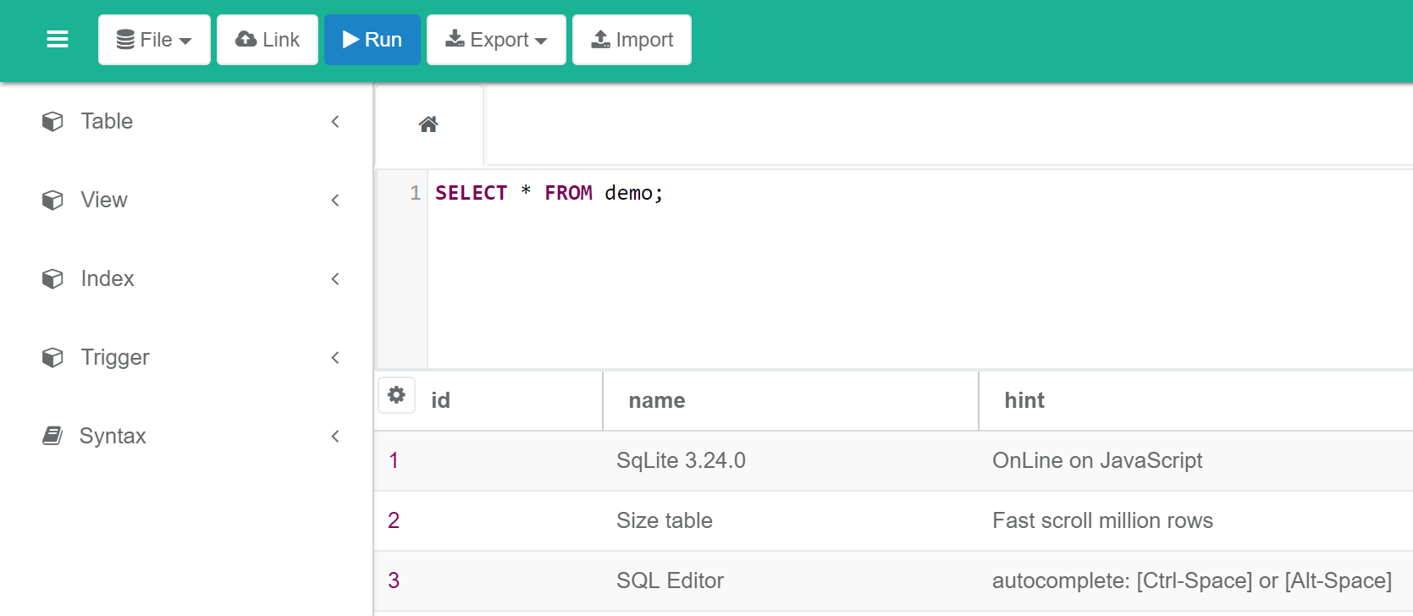
SQLite
https://sqliteonline.com/

