Slide 1
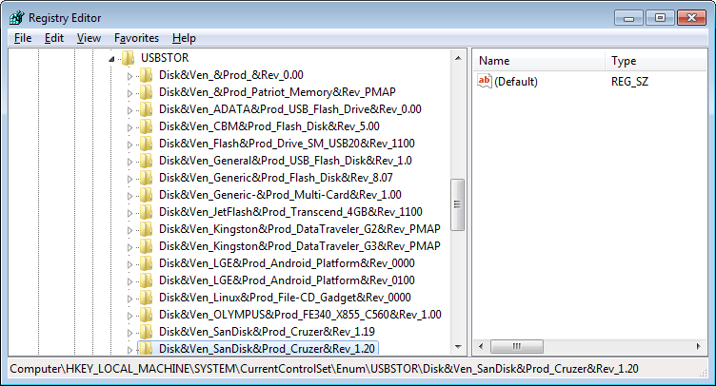
Microsoft Registry Editor
Selective connect USB-flash drives
This key stores information about the ever-connected USB-media.

Slide 2
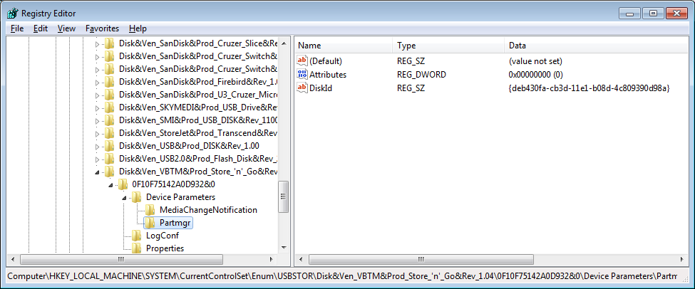
Microsoft Registry Editor
Get DiskID
serial number

Slide 3
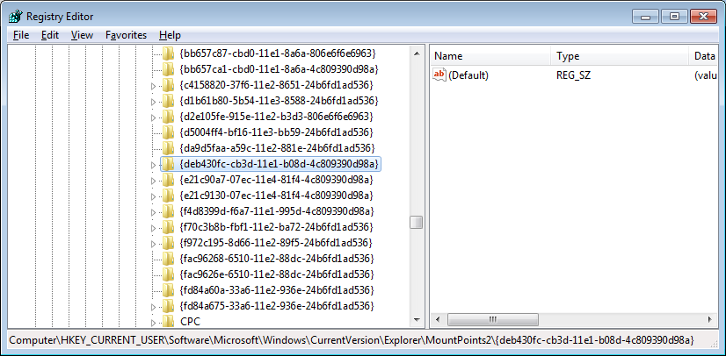
Microsoft Registry Editor
Get User
GUID

Slide 4
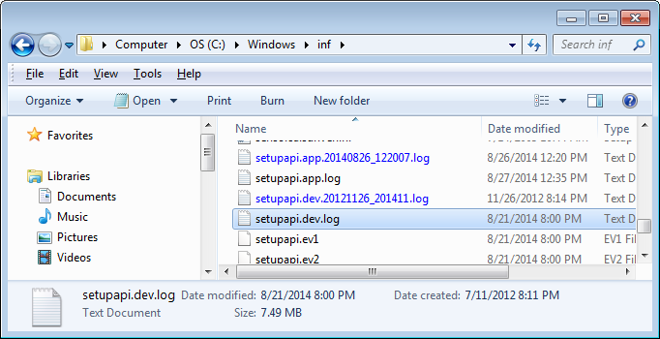
Microsoft Registry Editor
C:\Windows\inf\setupapi.dev.log

Slide 5
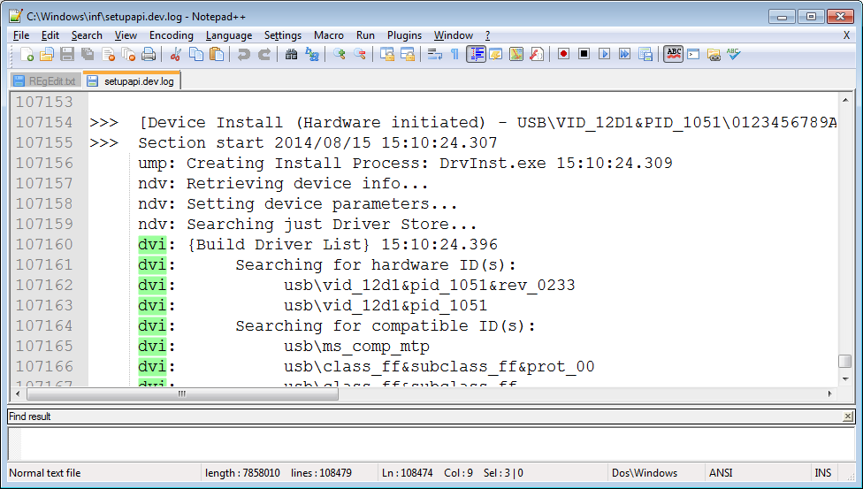
Microsoft Registry Editor
The first time a USB connection

Slide 6
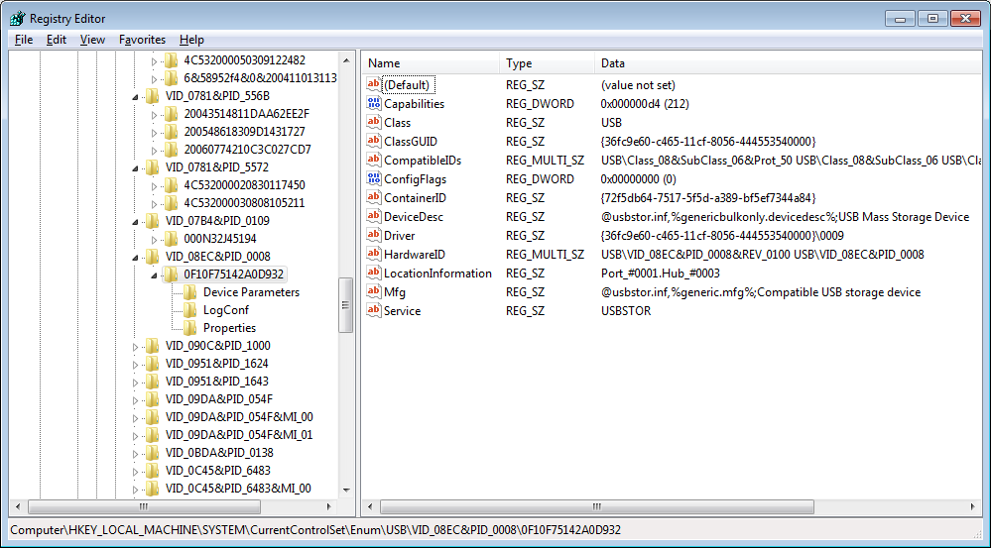
Microsoft Registry Editor
The last time a USB connection

Slide 7
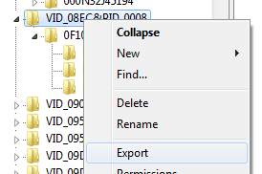
Microsoft Registry Editor
The last time a USB connection

Slide 8
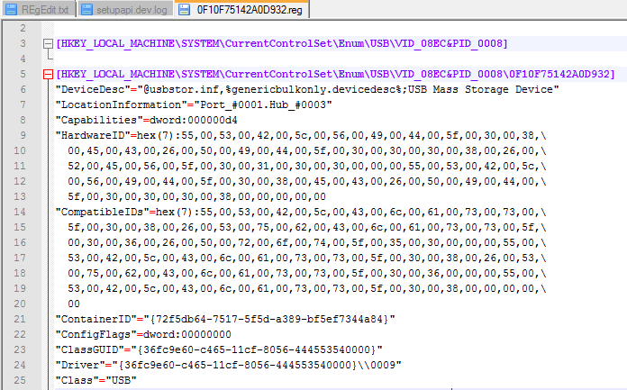
Microsoft Registry Editor
The last time a USB connection

Slide 9
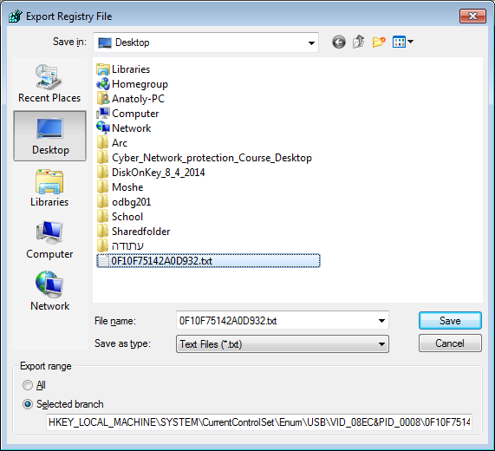
Microsoft Registry Editor
The last time a USB connection

Slide 10
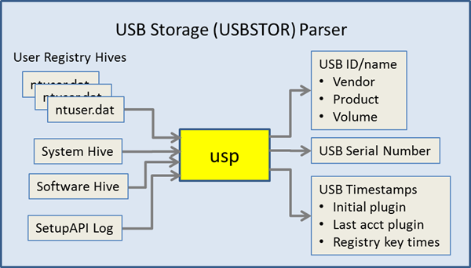
Microsoft Registry Editor
USBDeview
TZWorks LLC
Windows USB Storage Parser (usp)

Slide 11
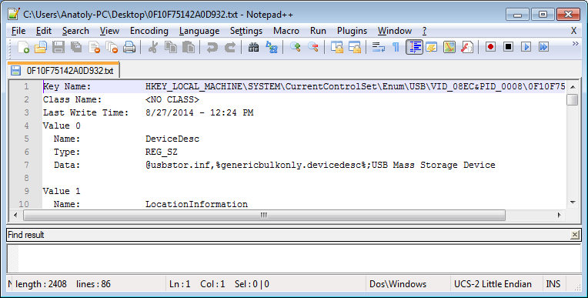
Microsoft Registry Editor
The last time a USB connection

Slide 12
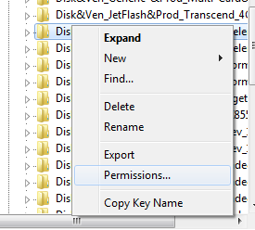
Microsoft Registry Editor
Selective connect USB-flash drives

