Slide 1
FAR manager

Slide 2
FAR manager
F1
Help
CTRL
ALT
F9
Menu

Slide 3
FAR manager
ALT
+
F1
Left panel

Slide 4
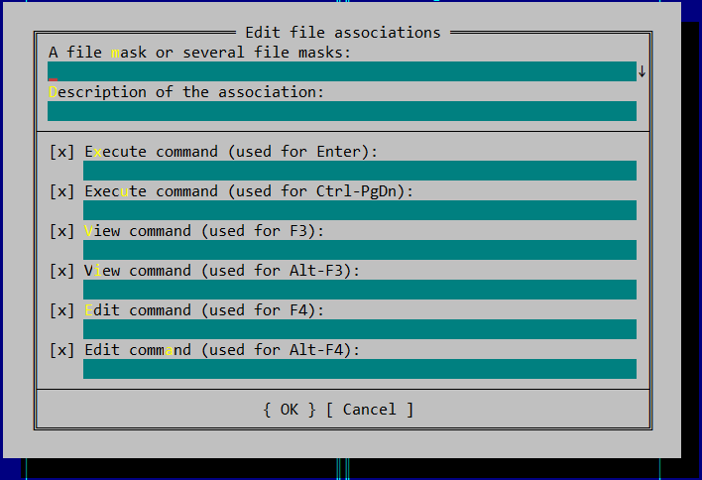
FAR manager
File associations

Slide 5
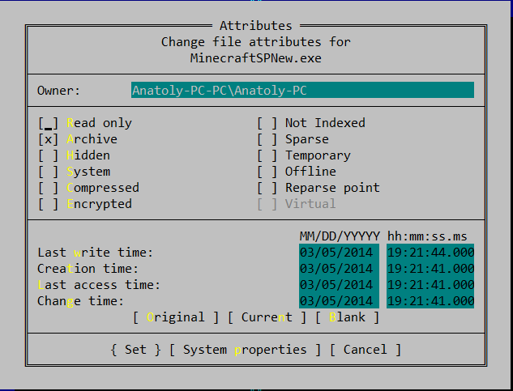
FAR manager
File attributes
CTRL
+
A

Slide 6
FAR manager
Task list
CTRL
+
W

