Slide 1
Kali-Linux
האלה קאלי בציור משנת 1728
https://en.wikipedia.org/wiki/Kali

Slide 2
Kali-Linux
https://www.kali.org/
Kali Linux is a Debian-derived Linux distribution designed for digital forensics and penetration testing.
Kali Linux is preinstalled with over 300 penetration-testing programs
https://www.kali.org/downloads/

Slide 3
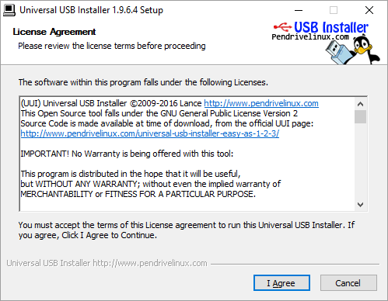
Kali-Linux
http://www.pendrivelinux.com/universal-usb-installer-easy-as-1-2-3/

Slide 4
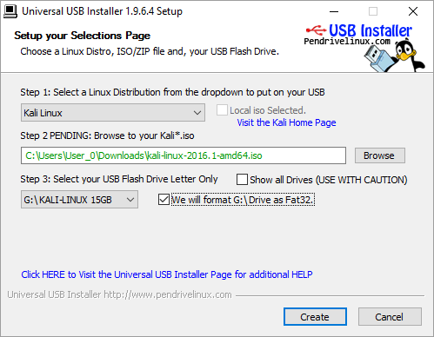
Kali-Linux

Slide 5
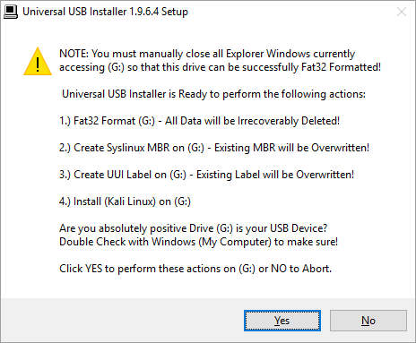
Kali-Linux

Slide 6
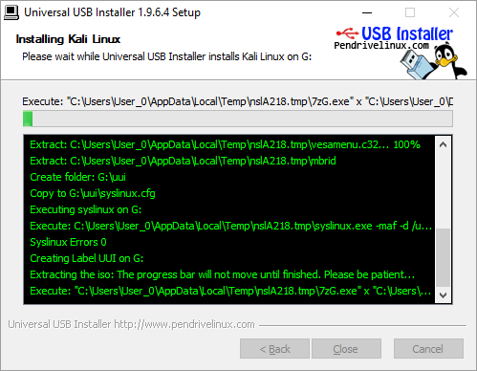
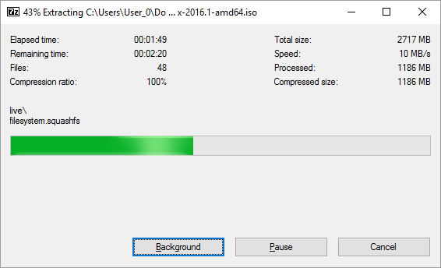
Kali-Linux

Slide 7
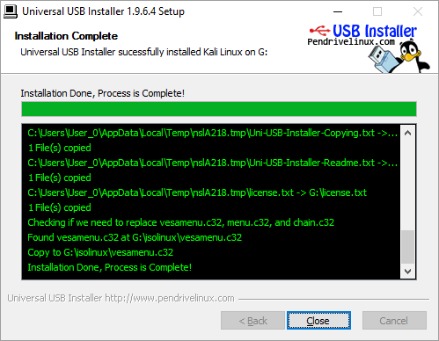
Kali-Linux

