Slide 1
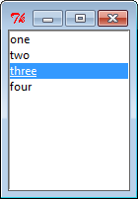
Tkinter
Listbox
The Listbox widget is used to display a list of items from which a user can select a number of items
from tkinter import *
root = Tk()
listbox=Listbox()
listbox.pack()
for item in ["one", "two", "three", "four"]:
listbox.insert(END, item)
root.mainloop()

Slide 2
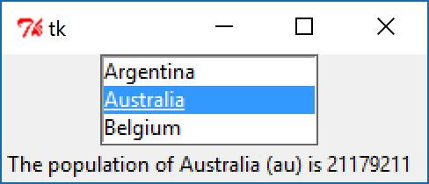
Tkinter
from tkinter import *
root = Tk()
countrycodes = ('ar', 'au', 'be')
countrynames = ('Argentina', 'Australia', 'Belgium')
cnames = StringVar(value=countrynames)
populations = {'ar':41000000, 'au':21179211, 'be':10584534}
statusmsg = StringVar()
def showPopulation(*args):
idxs = lbox.curselection()
if len(idxs)==1:
idx = int(idxs[0])
code = countrycodes[idx]
name = countrynames[idx]
popn = populations[code]
statusmsg.set("The population of %s (%s) is %d" % (name, code, popn))
c = Frame(root)
c.grid(column=0, row=0)
lbox = Listbox(c, listvariable=cnames, height=3)
status = Label(c, textvariable=statusmsg)
lbox.grid(column=0, row=0)
lbox.bind('<<ListboxSelect>>', showPopulation)
status.grid(column=0, row=4)
lbox.selection_set(0)
showPopulation()
root.mainloop()

