Slide 1
Tkinter
Text
Text widgets provide advanced capabilities that allow you to edit a multiline text and format the way it has to be displayed, such as changing its color and font.
import tkinter as tk
from tkinter import font
root = tk.Tk()
fnt = font.Font(family="Helvetica", size=20, weight=font.BOLD, slant=font.ITALIC)
txt = tk.Text(root,bg ="gray", fg="Yellow",font=fnt, bd=8)
txt.pack()
root.mainloop()

Slide 2
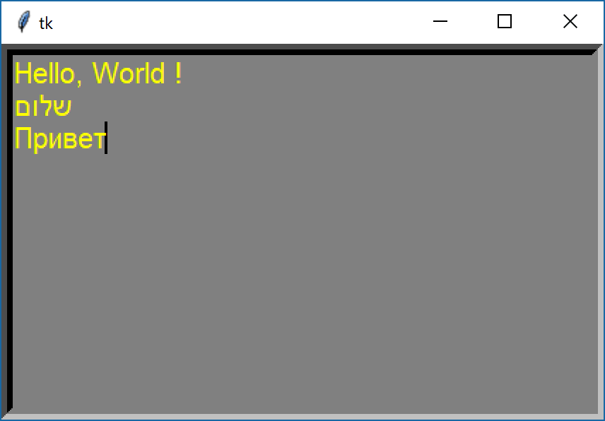
Tkinter
Text

Slide 3
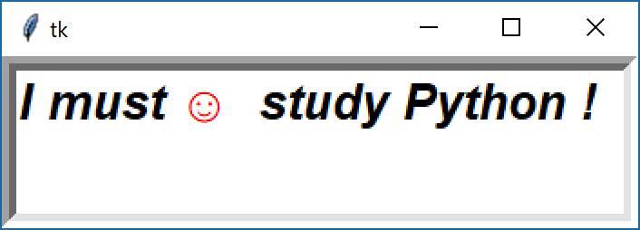
Tkinter
import tkinter as tk
from tkinter import font
root = tk.Tk()
fnt = font.Font(family="Helvetica", size=20, weight=font.BOLD, slant=font.ITALIC)
txt = tk.Text(root, bd=8, font = fnt)
txt.pack()
txt.focus_set()
txt.insert('1.1','I must study Python !')
txt.insert('1.6',' ☺ ', 'smile')
txt.tag_config('smile', foreground='red')
root.mainloop()

