Slide 1
Tkinter
Scrollbar
from tkinter import *
root = Tk()
w = Canvas(root, width=200, height=200,
scrollregion=(0,0,500,500))
w.pack(padx=10,pady=10)
w.create_text(400,100,text='Hello, World')
hbar=Scrollbar(root,orient=HORIZONTAL)
hbar.pack(side=BOTTOM,fill=X)
hbar.config(command=w.xview)
w.config(xscrollcommand=hbar.set)
root.mainloop()

Slide 2
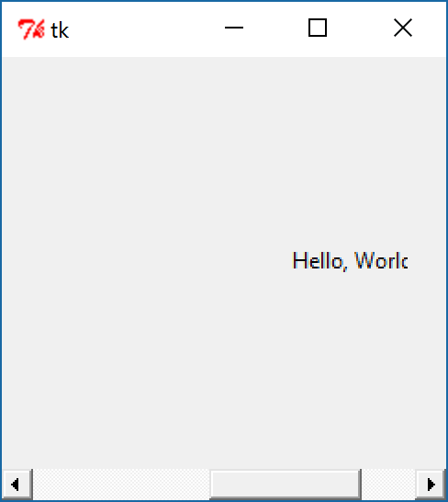
Tkinter
Scrollbar

